Slide 1

Supplier Reprograming Principles Coredo and WS0 Addon
Technical Hour

Slide 2
Agenda
1
Supplier Reprogramming Principles (Razvan Coban)
2
Coredo Tool Description and Usage (Daniel Mindru)

Slide 3
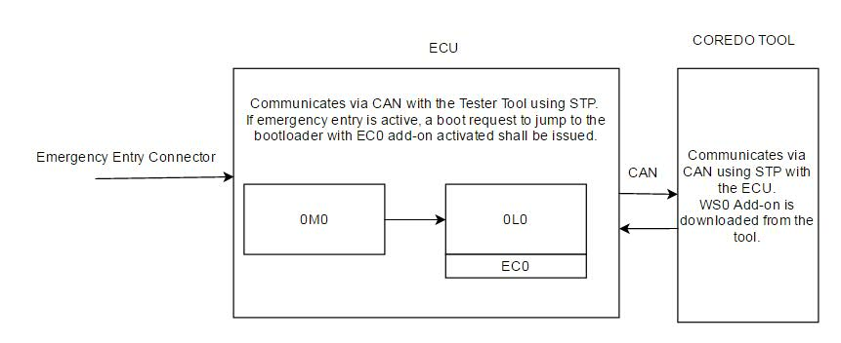
1. Supplier Reprogramming Principles
1.1. Why do we need supplier reprogramming.
After production, an ECU may be returned to Warranty Return Center for analysis in case of an issue.
The warranty colleagues can install/uninstall protections over the ECU if authorized, create dumps of the DFLASH and PFLASH and reprogram the application SW, calibration area and also flash a boot updater.

Slide 4
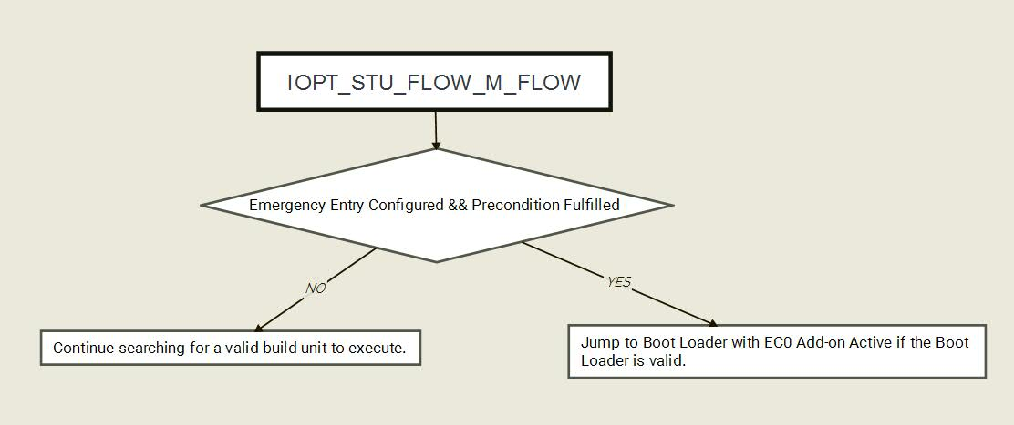
1. Supplier Reprogramming Principles
1.2. Emergency Entry Concept in EMS3
- Emergency Entry is considered active if the configured precondition is fulfilled:
DIO for Audi, Daimler
ADC for JLR
- The Emergency Entry precondition check is done in the Boot Manager.

Slide 5
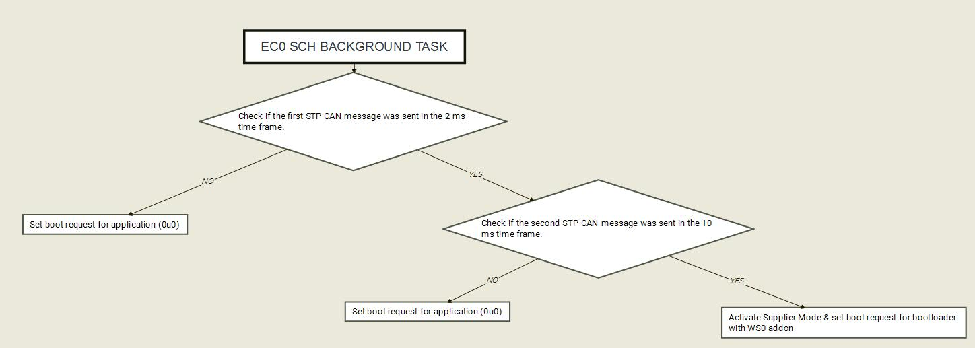
1. Supplier Reprogramming Principles
1.2.1. The EC0 Add-on
Uses STP Command C184 – Emergency entry
0xB8, 0x45
COREDO
ECU
0xA0
0xB8, 0x00
0xA0,0xB8, 0x00

Slide 6
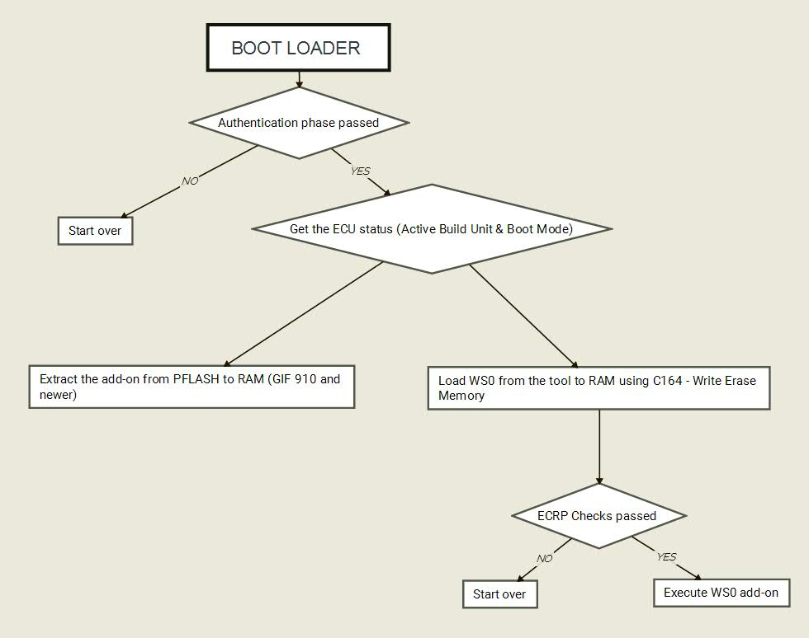
1. Supplier Reprogramming Principles
1.2.2 Loading WS0 in RAM

Slide 7
1. Supplier Reprogramming Principles
1.2.3. Authentication within the Boot Loader
Done through STP Command 181 (Authentication)
Initially, a default security level is present before authentication.
C131 – Get ECU Info
C150 – TSW Reset
C181 – Authentication
If authentication is passed, the security level is upgraded and aligned with the one already present when WS0 is running :
C131 – Get ECU Info
C150 – TSW Reset
C164 – Write Erase Memory
The authentication is managed through EAP interfaces (CSM / SMS).
On projects which use HSM, the authentication is performed inside the HSM.

Slide 8
1. Supplier Reprogramming Principles
1.2.3. Authentication within the Boot Loader
The authentication is managed through EAP interfaces (CSM / SMS).
On projects which use HSM, the authentication is performed inside the HSM.
The asymetric encryption algorithm : RSA-2048
The hash function for signature: SHA-256
The RSA encryption scheme: RSAES-PKCS1-v1_5
The RSA signature scheme is RSASSA-PKCS1-v1_5
Certificate content :
User public key
User allowed operations
Certificate signature

Slide 9
1. Supplier Reprogramming Principles
1.2.3. Authentication within the Boot Loader
User Login
Download the UserCertificate
Online Trust Center
COREDO
ECU
Sends the certificate
Generate N2 if user has authentication rights in certificate
N2 = 32 bytes Random number
APAR=AdministrativeParameter
Sends <APAR=1><N2>
Sends <APAR><N2><Signature>
Hash and check with public key
Positive response if ok

Slide 10
1. Supplier Reprogramming Principles
1.2.4. The WS0 Add-on
Supported features:
Dump the content of the build units located in PFLASH and the NVM content (DFLASH).
Reprogramming operations over the following build units:
Application.
Calibration.
Boot Updater.
Tuning protection operations:
Install & uninstall flash protection (PFLASH).
Install & uninstall host debug protection.
Install & uninstall HSM debug protection.
Sending of manual STP commands (e.g. dump the content of a certain address).

Slide 11
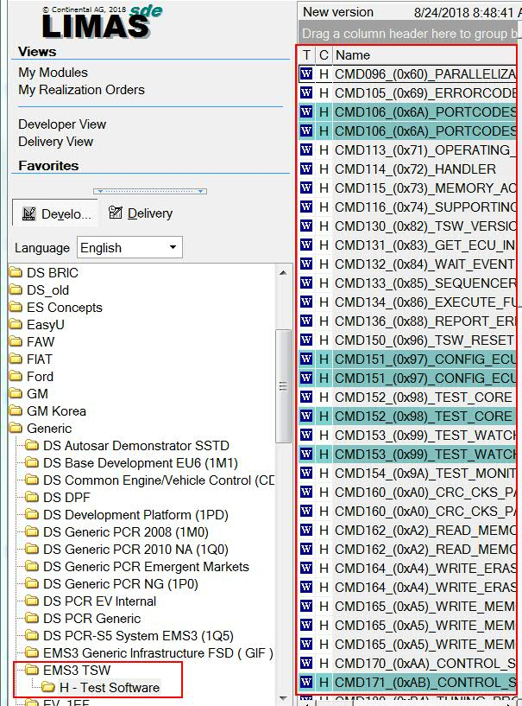
1. Supplier Reprogramming Principles
1.2.4. The WS0 Add-on
STP Commands used within WS0:
C131 – Get Ecu Info
C150 – TSW Reset
C160 – CRC & CKS Pattern
C162 – Read Memory
C164 – Write Erase Memory
C180 – TUNP
C186 – HSM Services
C250 – Remove HSM Debug Protection
LIMAS specification available for all existing STP
commands:

Slide 12
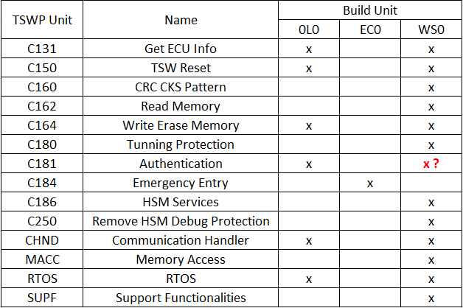
Repository Information
Minimum set of TSWP components to be integrated:

Slide 13

Coredo Tool introduction
Who needs to use a reprogramming / revival tool?
COREDO
Development phase
P HEV E SW SF PMT
Acti-Diag Author
Packages
development
Project team
SW, HW, System,
Prototype team
Supported Use-Cases:
EMS2 + EMS3 platform Emergency Entry Dump (Dflash, Pflash) Flash ECU content Lock / Unlock Protections Send STP request
Packages
COREDO
Production phase & serial life
Warranty return centers
Production Plants
Continental resident engineers

Slide 14

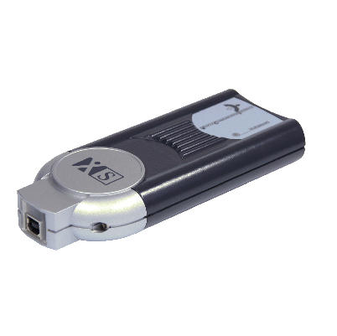
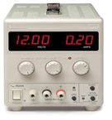
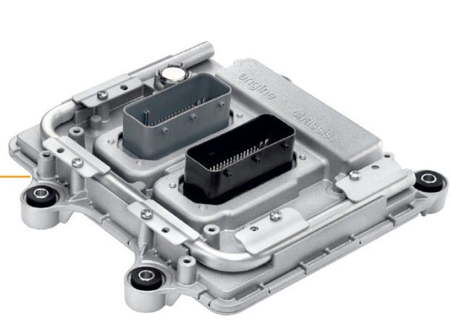
Tool chain description. Test setup
PC with COREDO 2.2.1 SW installation:
IT package CA0001809 (64b version&Win7) or CA0001808 (32b version&Win7)
This package install automatically SMC drivers and CardOS API
3 USB ports are required
VCI Vehicule Configuration Interface
Passthru +XS 2G
USB to CAN and/or K-line
USB
Dongle
Valid Coredo License
Coredo
Reprogramming Cable
project specific connector
CAN_H, CAN_L, VBAT(12V), GND
SMC
SmartCard
With private key for Security Access
(Only for serial ECU’s)
Power Supply
12 V
GND
!
If EE is implemented and used, then
Emergency Entry Pin shall also be conected to GND

Slide 15
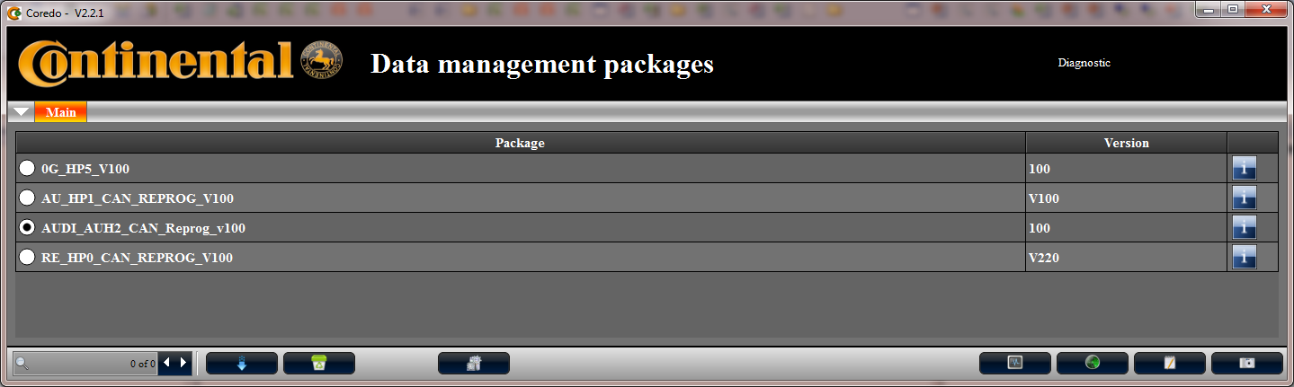
Tool chain description
Acti-Diag Workshop: in Continental is named COREDO and it is a tool used together with the packages developed by Acti-Diag Author for reprogramming reasons.
User is able to:
trace and interpret messages on CAN communication
use direct build formats like .hex, .s19 or .mot
dump, flash, erase ECU subsystem
send/receive messages

Slide 16
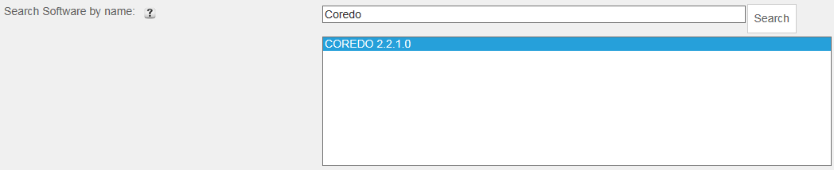
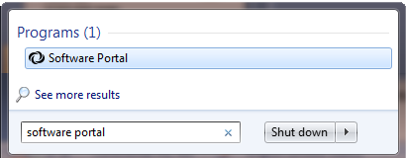

Coredo Tool installation
Go to SSP 7, search for Coredo and select COREDO 2.2.1.0:
For creating the SSP 7 request, follow the link details below:
Link details
After request was solved by IT, go to Start and search for Software Portal and run it

Slide 17

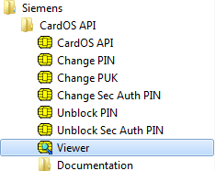
Coredo Tool installation
Select the Package „_DS CA0001809_COREDO_64bit_2.2.1.0_MUI“
Click on “Launch” button
This package will install Coredo tool on C:\LegacyApp\COREDO
Also installs drivers for SmartCard and CardOS API
Viewer
Can view information about
available KEYs on SMC

Slide 18
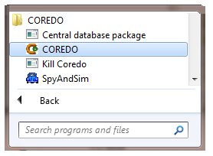
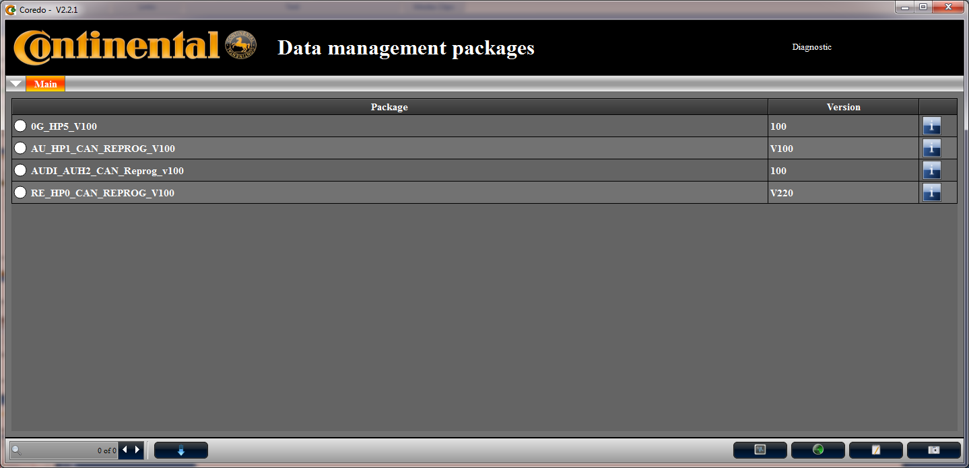
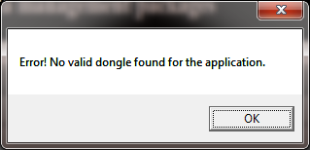
Coredo Tools startup
Run Coredo from: Start-> All Programs-> Coredo:
You forgot to plug-in Coredo
dongle to activate SW license
!
USB Coredo dongle must be
connected during tool usage

Slide 19
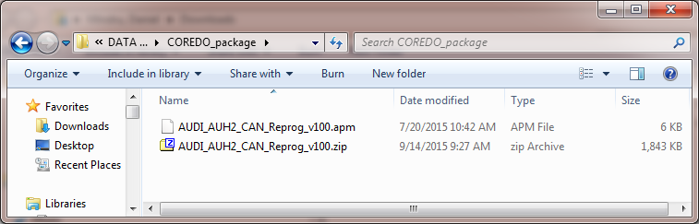
Package/Session description
P HEV E SW SF PMT team will develop packages with Acti-Diag
Packages are developed based on project specifications
User will use these packages with together Coredo
Packages are containing: *.apm and *.zip file
*.apm file is used to import package in Coredo

Slide 20
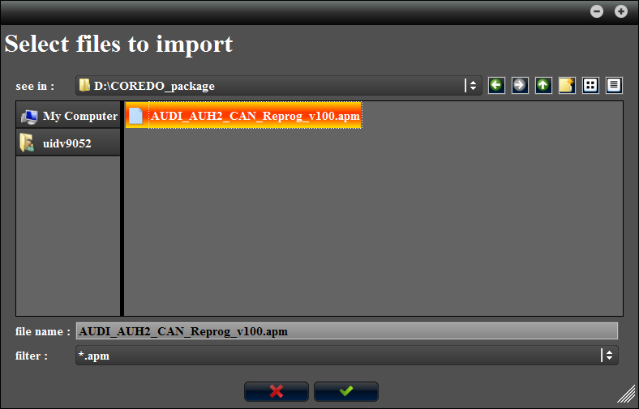

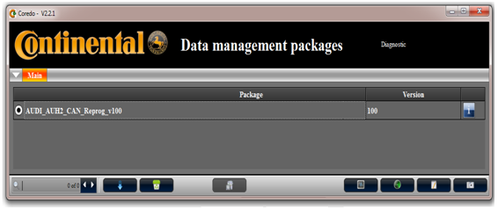

Coredo & Packages usage
At first Coredo startup, user has to navigate to the package location and select the *.apm file
Validate the selection to copy the package locally to Local Coredo Database on: c:\LegacyApp\COREDO\Data\Package
More packages can be imported with button or removed with button
Select package and click on button to Install and Run the package
Install operation: Package Data is copied to c:\LegacyApp\COREDO\Data\FlashFiles

Slide 21
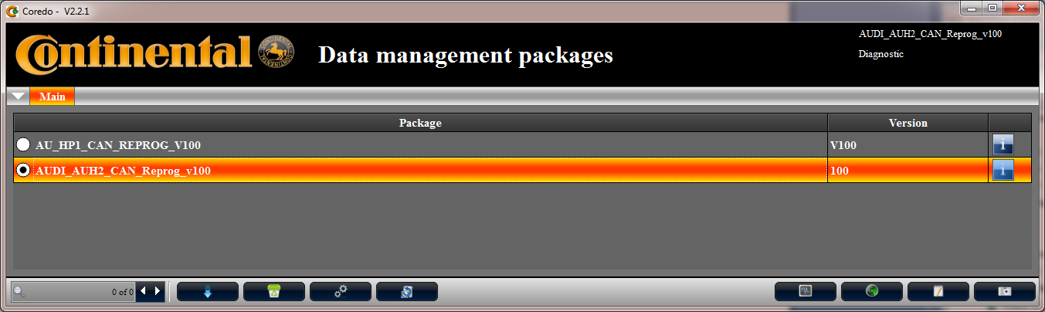
Coredo & Packages usage
If multiple sessions are already imported in Coredo Local Database, you have to select the needed one and Run or Reinstall and Run selected package
Run operation: Package Data already installed from previous Install&Run
Reinstall operation: Package Data is erased and reinstalled before running the package

